Slide 1
Module 3
SIMD array Processors
Synchronous array of parallel processors is an array processor
---consists of multiple PEs under the supervision of one CU.
Array processor handle SIMD streams (SIMD computers)
==designed to perform vector computations over matrices or arrays of data.

Slide 2
SIMD computers - 2 basic architectural organizations:
array processors, using random-access memory;
associative processors using content addressable
(or associative ) memory.

Slide 3
SIMD computer organization
Architectural configurations of SIMD array processors

Slide 4
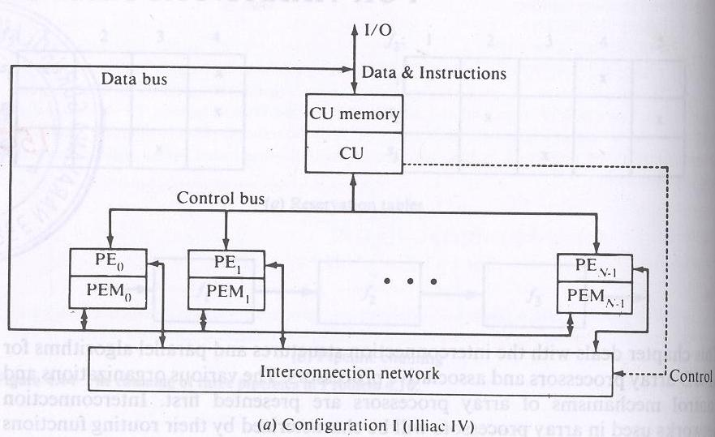

Slide 5
Configuration is structured with N synchronized PEs, under the control of one CU.
PEi is an ALU with attached working registers and local memory PEMi, for storage of distributed data.
CU has its main memory for the storage of programs. The system/user programs are executed under the control of CU.

Slide 6
User programs are loaded into the CU memory from an external source.
Function of CU is to decode instructions and determine where the decoded instructions should be executed.

Slide 7
Scalar/control type instructions are executed inside the CU.
Vector instructions are broadcast to the PEs for distributed execution to achieve spatial parallelism through duplicate arithmetic units (PEs).
All PEs perform same function synchronously in a lock-step fashion under the CU.

Slide 8
Vector operands are distributed to the PEMs before the parallel execution in the array of PEs.
Distributed data can be loaded into the PEMs from an external source via the system data bus/ via CU in a broadcast mode using the control bus.

Slide 9
PEs may be either active or disabled during an instruction cycle.
Masking vector is used to control the status of PEs during the execution of a vector instruction. Only enabled PEs participate in the execution of a vector instruction.

Slide 10
Data exchanges among PEs are done via an inter PE communication network (under the control of the control unit), which performs all data routing and manipulation functions.

Slide 11
An array processor is interfaced to a host computer through the control unit.
Host computer is a general-purpose machine which serves as “operating manager” of the entire system (consisting of the host and the processor array). Functions of the host computer include resource management and peripheral-I/O supervisions.

Slide 12
CU of the processor array supervises the execution of programs whereas host machine performs the executive and I/O functions with outside world.
In this sense, array processor can be considered a back end, attached computer, similar in function to pipeline attached processors.

Slide 13
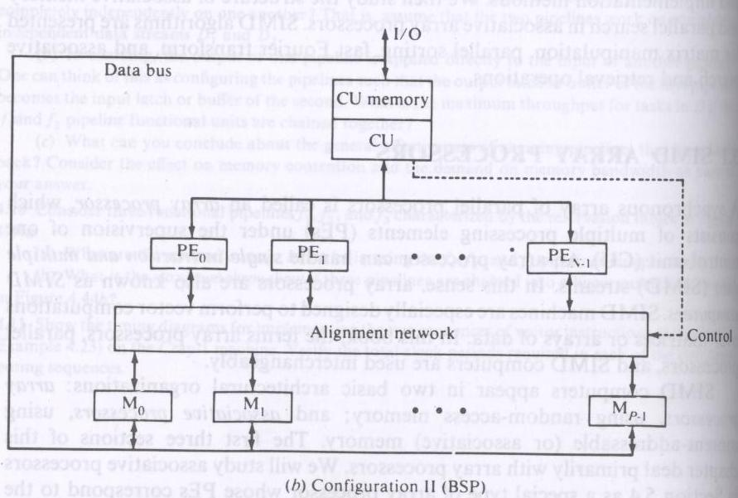

Slide 14
Difference between the configurations --in two aspects
I - local memories attached to the PEs are replaced by parallel memory modules shared by all PEs through an alignment network.
II - inter PE permutation network is replaced by the inter PE memory alignment network which is again controlled by CU.
Eg: Burroughs scientific processor (BSP).

Slide 15
----There are N PEs and P memory modules.
----2 numbers are not necessarily equal. They have been chosen to be relatively prime.
The alignment network is path-switching network between PEs and parallel memories.
------To allow conflict free accesses of the shared memories by as many PEs as possible.

Slide 16
Array processors become publicized with Illiac –IV.
The Burroughs Parallel Element Processing Ensemble (PEPE) and the Goodyear Aerospace Staran are associative array processors.
Extended from Illiac-IV are BSP and Goodyear Aerospace Massively parallel Processor (MPP).

Slide 17
SIMD computer C is characterized by the parameters:
C=<N,F,I,M>

Slide 18
N: no. of PEs. For eg for Illiac-IV has 64, BSP 16.
F: set of data routing functions
I: set of m/c instructions for scalar-vector, data-routing and the network-manipulation operations.
M: the set of masking schemes, where each mask partitions the set of PEs into the 2 disjoint subsets (enabled PEs and disabled PEs).

Slide 19
Masking and Data routing mechanisms
Components in a PE

Slide 20
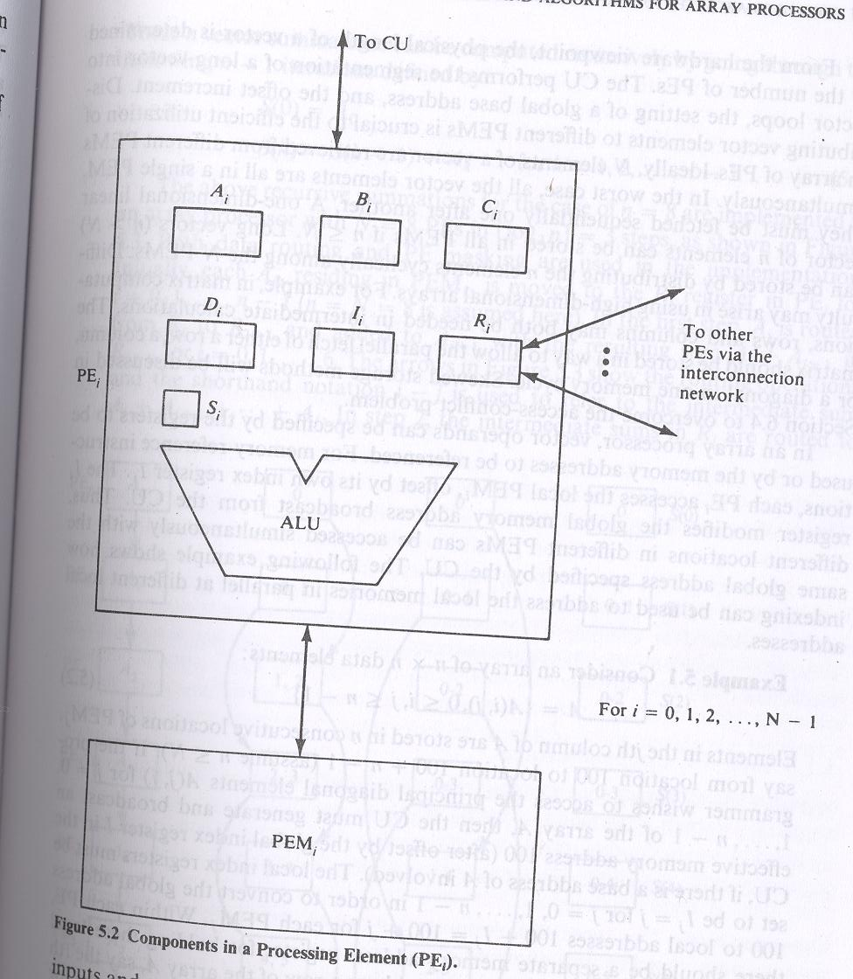

Slide 21
Here each PE is a processor with its own memory PEM; a set of working registers and flags , namely A, B, C and S; an ALU; a local index register I; an address register D and a data routing register R.
The R of each PE is connected to the R of other PE via the interconnection n/w.
When data transfer among PEs occur contents of R registers are being transferred.

Slide 22
The D is used to hold the m-bit address of the PE.
Some array processors use 2 routing registers - for i/p and o/p.
PE is either in active or inactive mode during instruction cycle.
If a PE is active, it executes the instruction broadcast to it by the CU otherwise it will not.
Masking schemes are used to specify the status flag S of PE.
S=1 indicate active PE and 0 for inactive PE.

Slide 23
In CU there is a global index register I and a masking register M. The M register has N bits. The ith bit of M is denoted as Mi.
The collection of Si flags for i=0,1,2,---N-1 forms a status register S for all the PEs.
Bit patterns in registers M and S are exchangeable upon the control of CU when masking is to be set.

Slide 24
Inter –PE communications
Network design is the fundamental decision in determining appropriate architecture of an interconnection network for an SIMD machine.
Decisions are to be made upon…..

Slide 25
Operation mode: 2 types of communication: synchronous and asynchronous.
Synchronous communication needed for establishing communication paths synchronously for either data manipulating function or for data instruction broadcast.
Asynchronous communication is needed for multiprocessing in which connection requests are issued dynamically.

Slide 26
Control strategy: A typical interconnection n/w consists of a no. of switching elements and interconnecting links.
Interconnection functions are realized by properly setting control of the switching elements.

Slide 27
Switching methodology:
---- circuit switching and packet switching.
circuit switching: physical path is established between source and destination.
packet switching: data is put in a packet and routed through the interconnection n/w without establishing a physical connection path.

Slide 28
N/w topology:
N/w is depicted by a graph.
----nodes represent switching points and edges represent communication links.
Topologies grouped into 2 categories:
-----static and dynamic.

Slide 29
Static topology: links between 2 processors are passive and dedicated buses cannot be reconfigured for direct connections to other processors.
Links in the dynamic category can be reconfigured by setting the n/ws active switching elements.

Slide 30
SIMD interconnection n/ws
Static v/s Dynamic n/ws
Topological structure of SIMD array processor is characterized by the data-routing n/w used in interconnecting PEs.

Slide 31
An inter PE communication n/w can be specified by a set of data routing functions.
Addresses of PEs in an SIMD m/c is S={0,1,2,…N-1}, each routing function f is a bijection (a one to one and onto mapping) from S to S.

Slide 32
When a routing function is executed via the interconnection n/w the PEi copies contents of Ri register into Rf(i) register of PEf(i). Data routing occurs in all active PEs simultaneously.
Inactive PE may receive data from another PE if a routing function is executed, but it cannot transmit data.
To pass data between PEs that are not directly connected in the n/w, the data must be passed through intermediate PEs by executing a sequence of routing functions through the interconnection n/w.

Slide 33
SIMD interconnection n/ws are classified based on n/w topologies: static n/ws and dynamic n/ws.

Slide 34
Static n/ws
Topologies in the static n/ws can be classified according to the dimensions (1D, 2D, 3D and hypercube) required for layout.

Slide 35
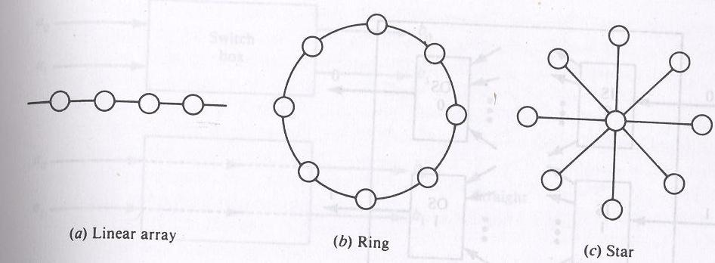

Slide 36
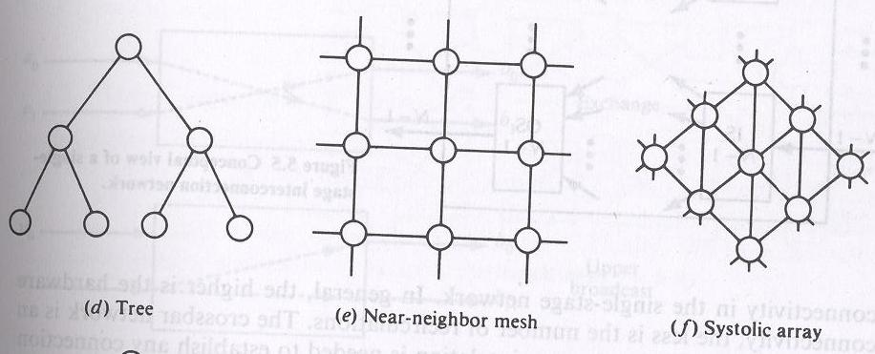

Slide 37
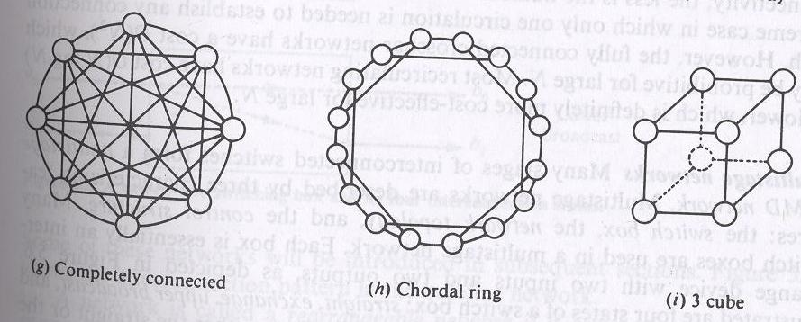

Slide 38
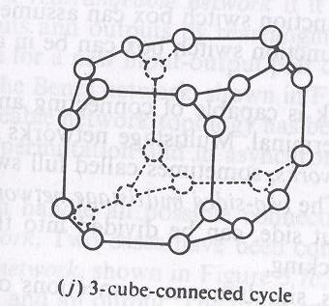

Slide 39
Eg of 1D : linear array
2D: ring, star, tree, mesh, and systolic array.
3D:completely connected, chordal ring, 3 cube, 3 cube connected cycle.
A D dimensional W-wide hypercube contains W nodes in each dimension and there is a connection to a node in each dimension.
Mesh and 3 cube are actually 2 and 3D hypercubes.

Slide 40
Dynamic n/w: 2 classes
Single stage v/s multistage
Single stage n/w:
A single stage n/w is a switching n/w with N i/p selectors (IS) and N o/p selectors (OS).

Slide 41
Conceptual view of a single stage interconnection n/w

Slide 42
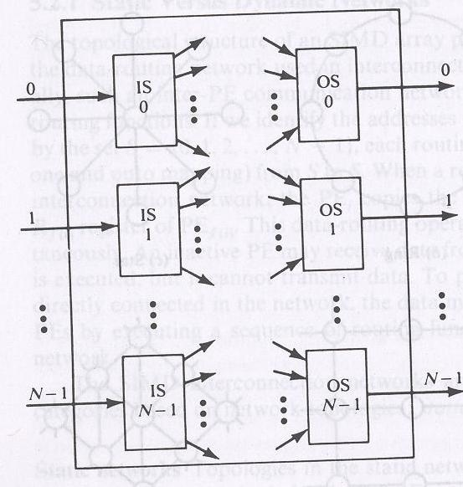

Slide 43
IS is a 1 to D demultiplexer and OS is an M to1 multiplexer where 1<=D<=N and 1<=M<=N.
Crossbar switching n/w is a single stage n/w with D=M=N.
To establish a connecting path, different path control signals will be applied to all IS and OS.

Slide 44
----Also called recirculating n/w.
Data items may have to recirculate through the single stage several times before reaching their final destinations.
The no. of recirculations needed depends on the connectivity in the single stage n/w.

Slide 45
Multistage n/w:
Many stages of interconnected switches form a multistage SIMD network.
Multistage n/ws are described by 3 characterizing features: switch box, network topology and control structure.

Slide 46
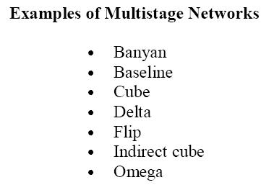

Slide 47
A two by two switching box and its 4 interconnection states

Slide 48
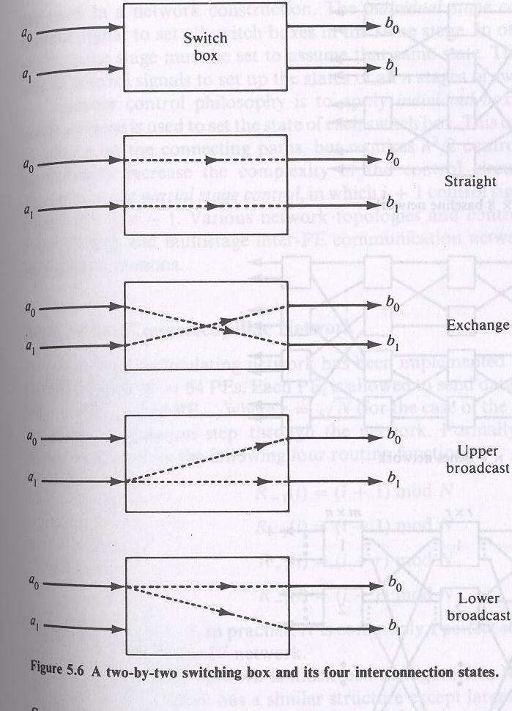

Slide 49
Many switch boxes are used in a multistage n/w.
Each box is an interchange device with 2 i/ps and 2 o/ps.
4 states of switch box:
straight , exchange, upper broadcast and lower broadcast.

Slide 50
A 2 function switch box can assume either the straight or the exchange states.
A 4 function switch box can be in any one of the 4 legitimate states.

Slide 51
A multistage n/w is capable of connecting an arbitrary i/p terminal to an arbitrary o/p terminal.
Multistage n/w can be 1 sided or 2 sided.
1 sided n/w, called full switches have i/p-o/p ports on the same side.
2 sided multistage n/w usually have an i/p side and an o/p side, can be divided into 3 classes:
blocking, rearrangeable and nonblocking.

Slide 52
In blocking n/ws , simultaneous connections of more than one terminal pair may result in conflicts in the use of n/w communication links.
Eg : data manipulator, omega, flip, n cube and baseline.
Rearrangeable: if it can perform all possible connections between i/ps and o/ps by rearranging its existing connections so that a connection path for a new i/p-o/p pair can always be established.
eg Benes n/w

Slide 53
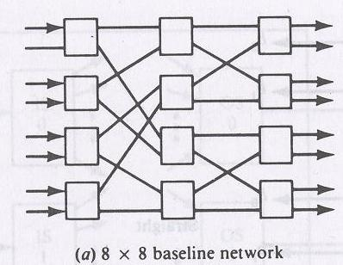
Multistage interconnection n/ws
Baseline network

Slide 54
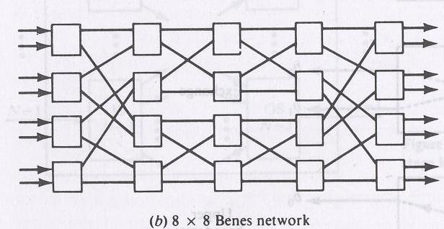
Benes n/w

Slide 55
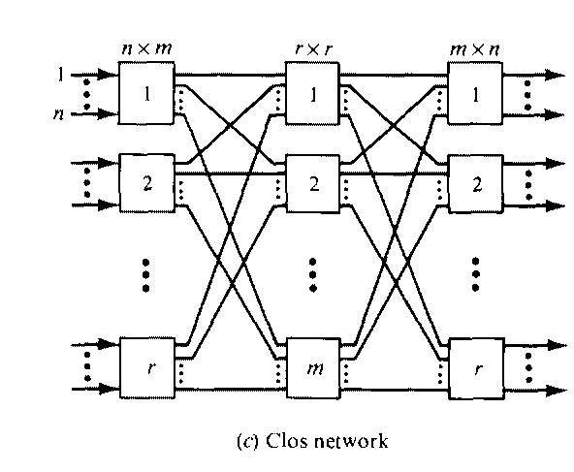
Clos network

Slide 56
N/w which can handle all possible connections without blocking is called a nonblocking n/w.
2 cases,
I: Clos n/w, a one to one connection is made between an i/p and o/p.
II : one to many connections.

Slide 57
Multistage n/w consists of n stages where N=2^{n} is the no. of i/p and o/p lines. Therefore each stage, may use N/2 switch boxes.
The interconnection patterns from stage to stage determine the n/w topology.
Each stage is connected to the next stage by at least N paths.

Slide 58
Control structure of a network determines how the states of the switch boxes will be set.
-----2 types
Individual stage control uses the same control signal to set all switch boxes in the same stage.
Individual box control a separate control signal is used to set the state of each switch box.

Slide 59
Mesh-connected Illiac n/w
Single stage recirculating n/w is implemented in Illiac-IV array processor with N=64 PEs.
Each PE_{i} is allowed to send data to any one of PE _{i+1}, PE_{i-1}, PE_{i+r}, and PE_{i-r} where r = √N in one circulation step through the n/w.

Slide 60
Illiac n/w is characterized by the following 4 routing functions:
R₊₁(i) = (i+1)mod N
R₋₁(i) = (i-1)mod N
R_{+r}(i) = (i+r)mod N
R_{-r}(i) = (i-r)mod N
Where 0<=i<=N-1. N is commonly a perfect square.

Slide 61
Real Illiac n/w has a similar structure except larger in size.

Slide 62
The o/ps of ISi are connected to the i/ps of OSj for j=i+1, i-1, i+r, i-r. On the other hand, OSj gets i/ps from ISi for i=j-1, j+1, j-r and j+r.
Each PEi is directly connected to its 4 nearest neighbours in the mesh n/w.

Slide 63
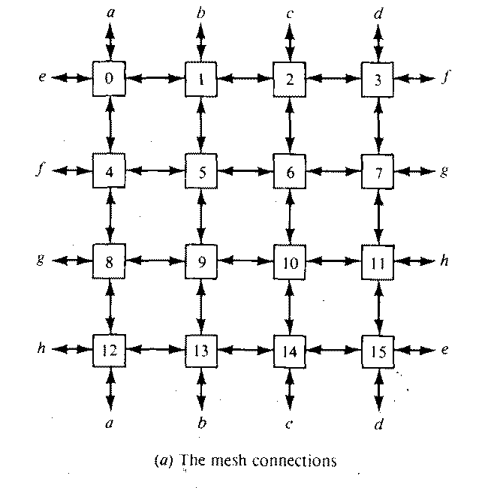

Slide 64
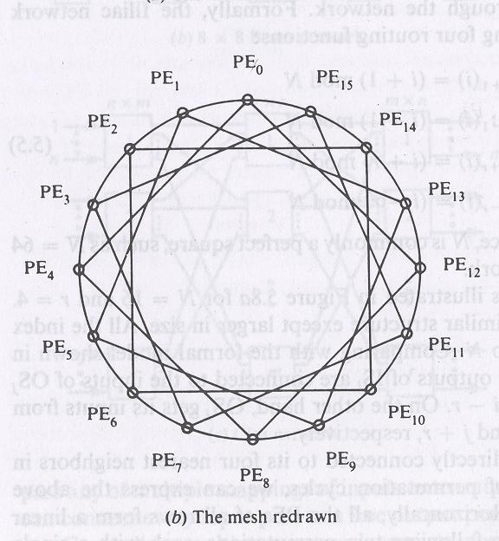

Slide 65

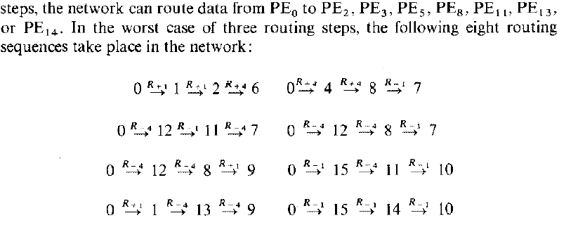
This graph shows that four PEs can be reached from any PE in one step, seven PEs in two steps, and eleven PEs in three steps.
In general, it takes l steps (recirculations) to route data from PEi to any other PEj in an Illiac network of size N where / is upper-bounded by
Without a loss of generality, we illustrate the cases when PE₀ is a source node .
PE1 PE₄, PE₁₂, or PE1₅ is reachable in one step from PE₀. In two

Slide 66
Cube interconnection n/ws
The cube can be implemented either as a recirculating n/w or as a multistage n/w for SIMD machines.
A 3D cube

Slide 67
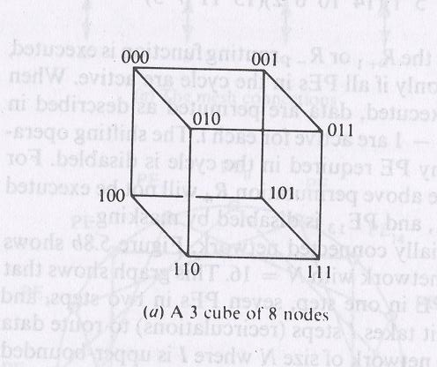

Slide 68
Vertical lines connect vertices (PEs) whose address differ in the most significant bit position. Vertices at both ends of the diagonal lines differ in the middle bit position.
Horizontal lines differ in the least significant bit position. This unit cube concept can be extended to an n dimensional unit space called an n cube with n bits per vertex.
A cube n/w for a SIMD m/c with N PEs corresponds to an n cube where n=log₂ N.

Slide 69
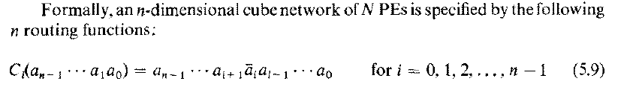
The interconnections of the PEs corresponding to the three routing functions C0, C1, and C2 are shown separately.

Slide 70
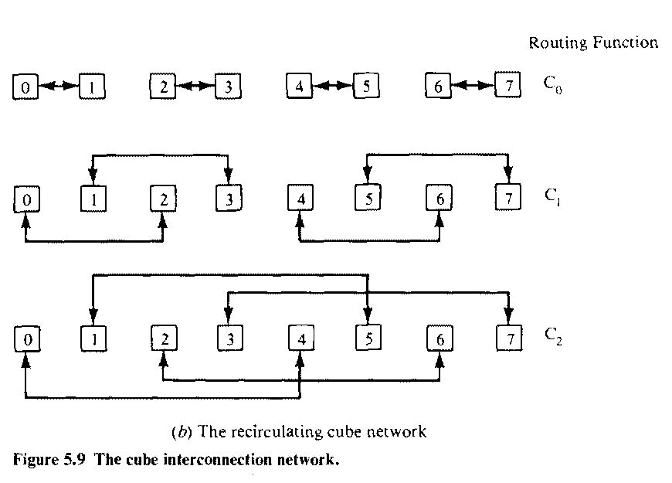

Slide 71
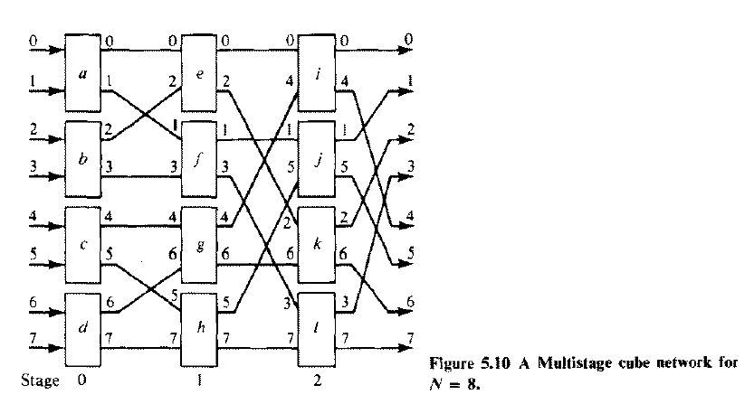
Implementation of a single stage cube network for N=8

Slide 72
Barrel shifter and data manipulator
Barrel shifters are also known as plus-minus-2^{i} (PM2I) networks.
This type of n/w is based on following routing functions:
B_{+i}(j) =(j+2^{i})(mod N)
B_{-i}(j) =(j-2^{i})(mod N)
Where 0<=j<=N-1, 0<=i<=n-1 and n=log₂N.

Slide 73
The following equivalence is revealed when r=√N =2^{n/2}:
B₊₀ = R₊₁
B₋₀ = R₋₁
B_{+n/2} = R_{+r}
B_{-n/2} = R_{-r}
This implies Illiac routing functions are a subset of the barrel shifting functions. In addition to adjacent +-1 and fixed distance +-r shiftings, the barrel shifting functions allow either forward or backward shifting of distances which are the integer power of two, ie +-1, +-2,+-4,…+-2^{n/2},..,..,..+-2^{n-1.}

Slide 74
Each PE in a barrel shifter is directly connected to 2(n-1)PEs.
Connectivity in a barrel shifter is increased from Illiac n/w by having (2n-5). 2^{n-1} more links.

Slide 75
Illiac n/w has 32 direct links and the same size barrel shifter has 56 links. The two n/ws are identical only when the size is reduced to be no greater than n=2 or N=5.

Slide 76

The barrel shifter can be implemented as either recirculating single-stage n/w or as a multistage n/w.
The speedup of a barrel shifter over the iIliac network of the same size can be expressed by
For a single case barrel shifter of size N=2^{n}, the minimum no. of recirculations B is upper bounded by
B <=log₂N
-------
2

Slide 77
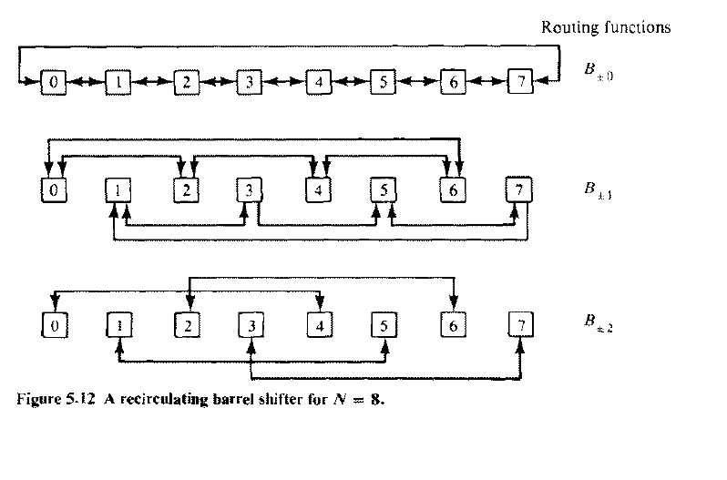
The barrel shifting functions B+-0, B+-1 and B+-2 are executed by the interconnection patterns shown.

Slide 78
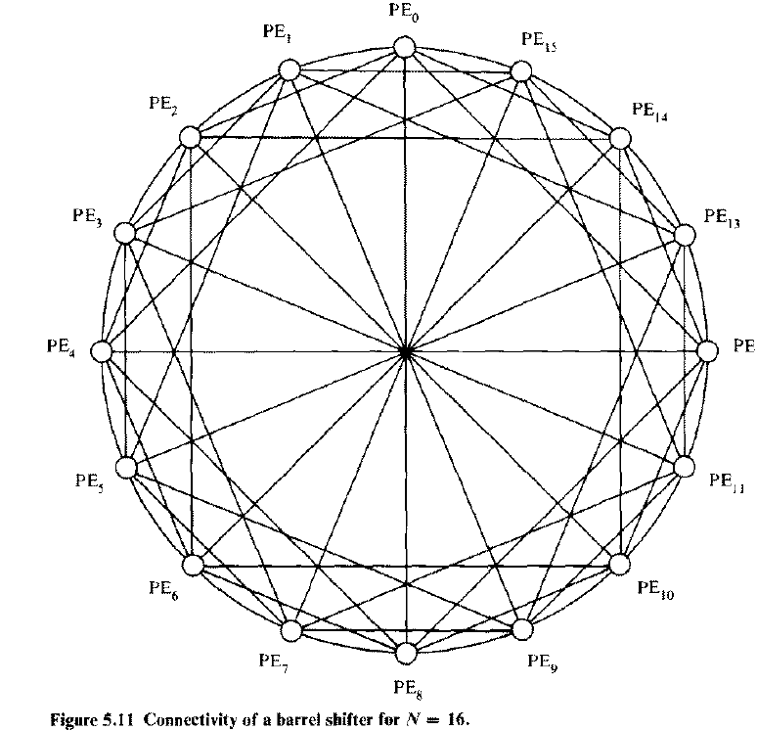

Slide 79
A barrel shifter has been implemented with multiple stages in the form of a data manipulator.
The data manipulator consists of n stages of N cells
Each cell is essentially a controlled shifter. This n/w is designed for implementing manipulating functions such as permuting, replicating, spacing, masking, and complementing.
To implement a data manipulating function, proper control lines of the 6 groups (u₁^{2i}, u₂^{2i}, h₁^{2i}, h₂^{2i}, d₁^{2i}, d₂^{2i}) in each column must be properly set through the use of the control register and the associated decoder.

Slide 80
For 0<=k<=N-1 and 0<=i<=n-1, the kth cell at stage i has 3 i/ps, 3 sets of o/ps and 3 control signals.
Individual stage control is used with 3 sets of control signals per stage.
The control lines ui, hi, and di are connected to the AND gates in each cell of stage i.

Slide 81
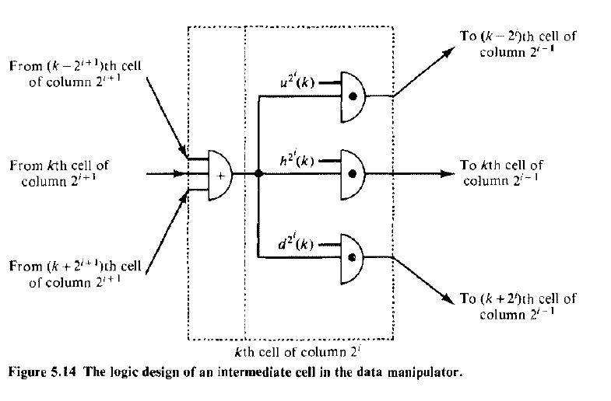

Slide 82
Shuffle Exchange and Omega networks
The class of shuffle-exchange networks is based on 2 routing functions shuffle (S) and exchange (E). Let A = a_{n-1}…a₁a₀ be a PE address.
S(a_{n-1}…a₁a₀) = a_{n-2}…a₁a₀a_{n-1}
Where 0<=A<=N-1 and n=log₂N.
The cyclic shifting of the bits in A to the left for one bit position is performed by the S function. This action corresponds to perfectly shuffling a deck of N cards.

Slide 83
The perfect shuffle cuts the deck into 2 halves from the center and intermixes them evenly.
The inverse perfect shuffle does the opposite to restore the original ordering.

Slide 84
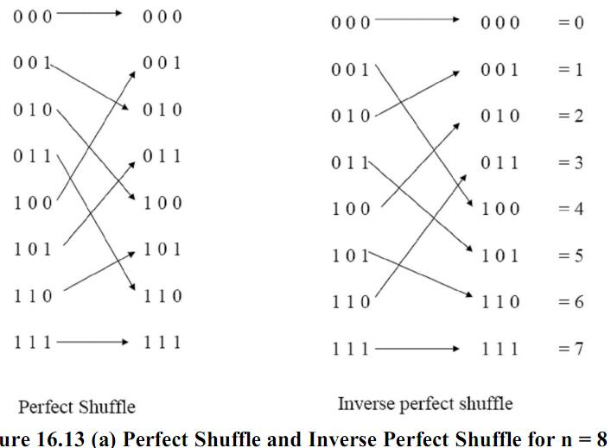

Slide 85
The exchange routing function E is defined by
E (a_{n-1}…a₁a₀) = a_{n-1}…a₁a_{n}
The complementing of the least significant digit means the exchange of data between two PEs with adjacent address.
E(A)=C₀(A), where C₀ is the cube routing function,
C _{i}(a_{n-1}….a₁a₀) = a_{n-1}…a_{i}+a_{i}a_{i-1}…a₀ for i=0,1,2,…n-1.

Slide 86
These shuffle exchange functions can be implemented as either a recirculating n/w or a multistage n/w.
For N=8, a single stage recirculating shuffle –exchange n/w is shown as:

Slide 87
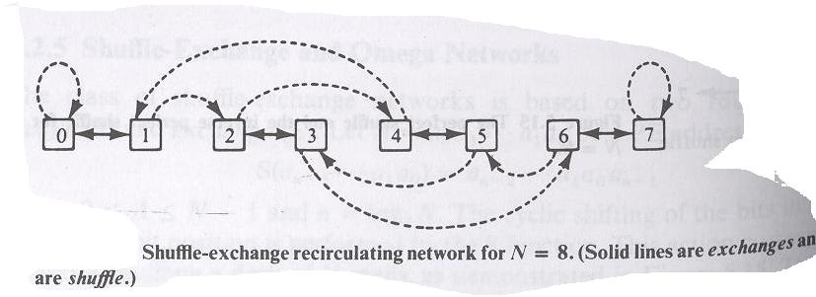
Dashed lines

Slide 88
The use of recirculating shuffle-exchange n/w for parallel processing was proposed by Stone.
A no. of parallel algorithms can be effectively implemented with the use of shuffle and exchange functions. The eg. include fast Fourier transform (FFT), polynomial evaluation, sorting, matrix transposition etc.

Slide 89
The shuffle exchange functions have been implemented with the multistage Omega n/w by Lawrie.
Omega n/w for N=8.

Slide 90
An n X n Omega n/w consists of n identical stages.
Between 2 adjacent stages is a perfect shuffle interconnection.
Each stages has N/2 switch boxes under independent box control.
Each box has 4 functions.
The switch boxes can be repositioned.

Slide 91
The ncube network has the same interconnection topology as the repositioned Omega. The 2 n/w differ in 2 aspects.
The cube n/w uses 2 function switch boxes, whereas the Omega n/w uses 4 function switch boxes.
The data flow directions in the 2 n/ws are opposite to each other.

Slide 92
